Slide 1
IBM University Engagement Project Submission
“Exploring the Power of Agentic AI with IBM Granite and LangFlow”

Slide 2

Project Tile – Brain Route AI
also called LEARN MATE
Domain of Project – AI, Agentic AI, Education Technology (EdTech)
Student Name | Recent Passport Photo | Email ID | Mobile number [WhatsApp]
PEDISETTI JYOTHSNASREE |  | AICTE: jyothsnasree012@gmail.com LMS OR IBMSKILLSBUILD: jyothsnawork0123@gmail.com | 8897573579

Slide 3
Problem Statement -
Problem Statement 12 :Agentic AI for Personalized Course Pathways
The Challenge
Students often struggle to identify the right learning path that aligns with their interests
and long-term goals due to the overwhelming number of online courses and a lack of personalized
guidance. Brain Route AI aims to solve this by acting as an Agentic AI coach that interacts with students,
understands their interests (like Frontend Development, Cybersecurity, UI/UX Design, etc.), assesses their
current skill level, and dynamically builds a personalized course roadmap that adapts over time based on
progress and preferences
The Objective
Build an AI-powered personalized course pathway assistant called Brain Route AI using IBM Cloud, Prompt Lab, IBM watsonx Orchestrate ,and IBM Granite Models.
The system should:
Recommend personalized learning pathways based on student interests and career goals
Analyze skill levels and identify missing competencies
Suggest relevant courses, certifications, and learning resources
Adapt learning roadmaps based on progress and preferences
Provide career-focused recommendations for industry readiness
Help students stay motivated with progress tracking and milestone visualization

Slide 4
Technology Used
Tech Stack (Mandatory) Use of IBM Cloud Lite services / IBM Granite is mandatory
I used:
IBM Cloud lite services
IBM watsonx Orchestrate
Prompt Lab
IBM Granite Models
IBM watsonx.ai Runtime
IBM Cloud + Prompt Lab + IBM Granite Models
IBM CLOUD + IBM watsonx Orchestrate +IBM watsonx.ai Studio +IBM watsonx.ai Runtime

Slide 5
Proposed Solution -
Proposed Solution: AI-Powered Nutrition Agent
Brain Route AI is an intelligent Agentic AI-based learning assistant designed to help students discover the right educational and career pathway according to their interests and goals.
The system uses IBM Granite models through Prompt Lab to understand student preferences, analyze skill levels, and generate personalized learning roadmaps.
The solution works through multiple AI agents collaborating together to deliver adaptive and intelligent learning guidance. The system can recommend courses, certifications, projects, and skill-building activities based on domains such as Frontend Development, UI/UX Design, Cybersecurity, Data Science, AI/ML, and Cloud Computing.
The platform continuously adapts recommendations based on user progress, completed courses, and changing interests. This creates a dynamic and personalized learning experience similar to having a real AI mentor.
The solution also integrates RAG-based retrieval to fetch accurate and relevant course information from trusted learning platforms and educational resources
Overall, Brain Route AI acts as a smart digital career mentor that helps students make informed learning decisions and achieve their long-term goals effectively.

Slide 6
Technology Used
IBM Cloud
Provides a secure and scalable cloud environment for running AI-powered educational solutions and deploying intelligent services.
Watsonx Orchestrate
Used for Agentic AI workflow Conversational interaction AI orchestration User guidance
IBM Prompt Lab
Used for prompt engineering, testing prompts, refining AI responses, and generating personalized learning recommendations.
IBM Granite Models
Used for reasoning, roadmap generation, personalized recommendations, summarization, and intelligent conversational guidance.

Slide 7
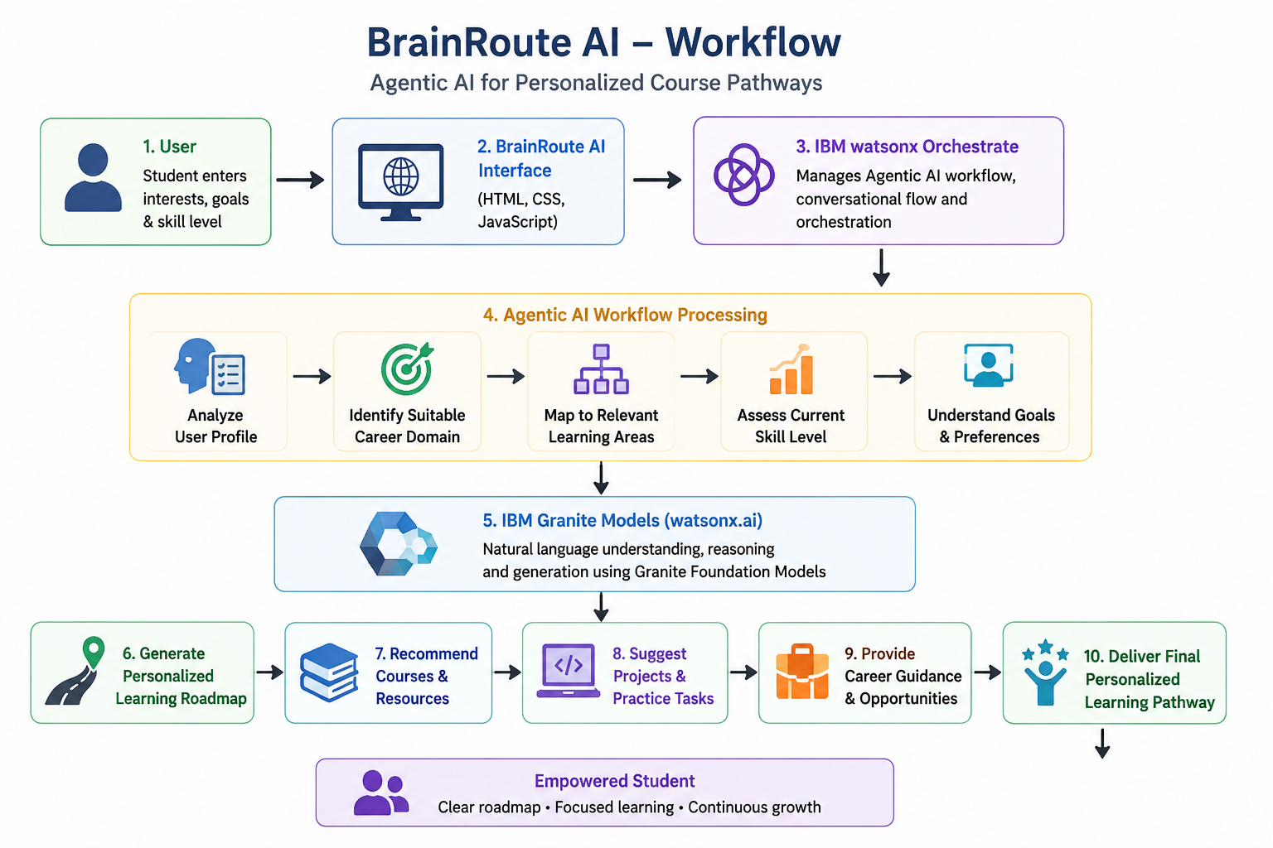
WORKFLOW

Slide 8
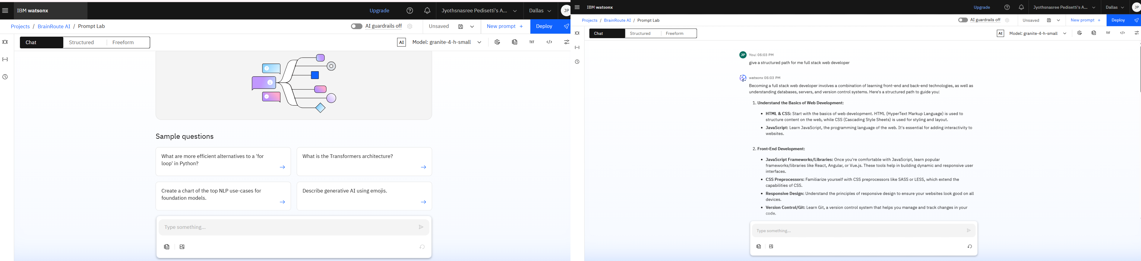
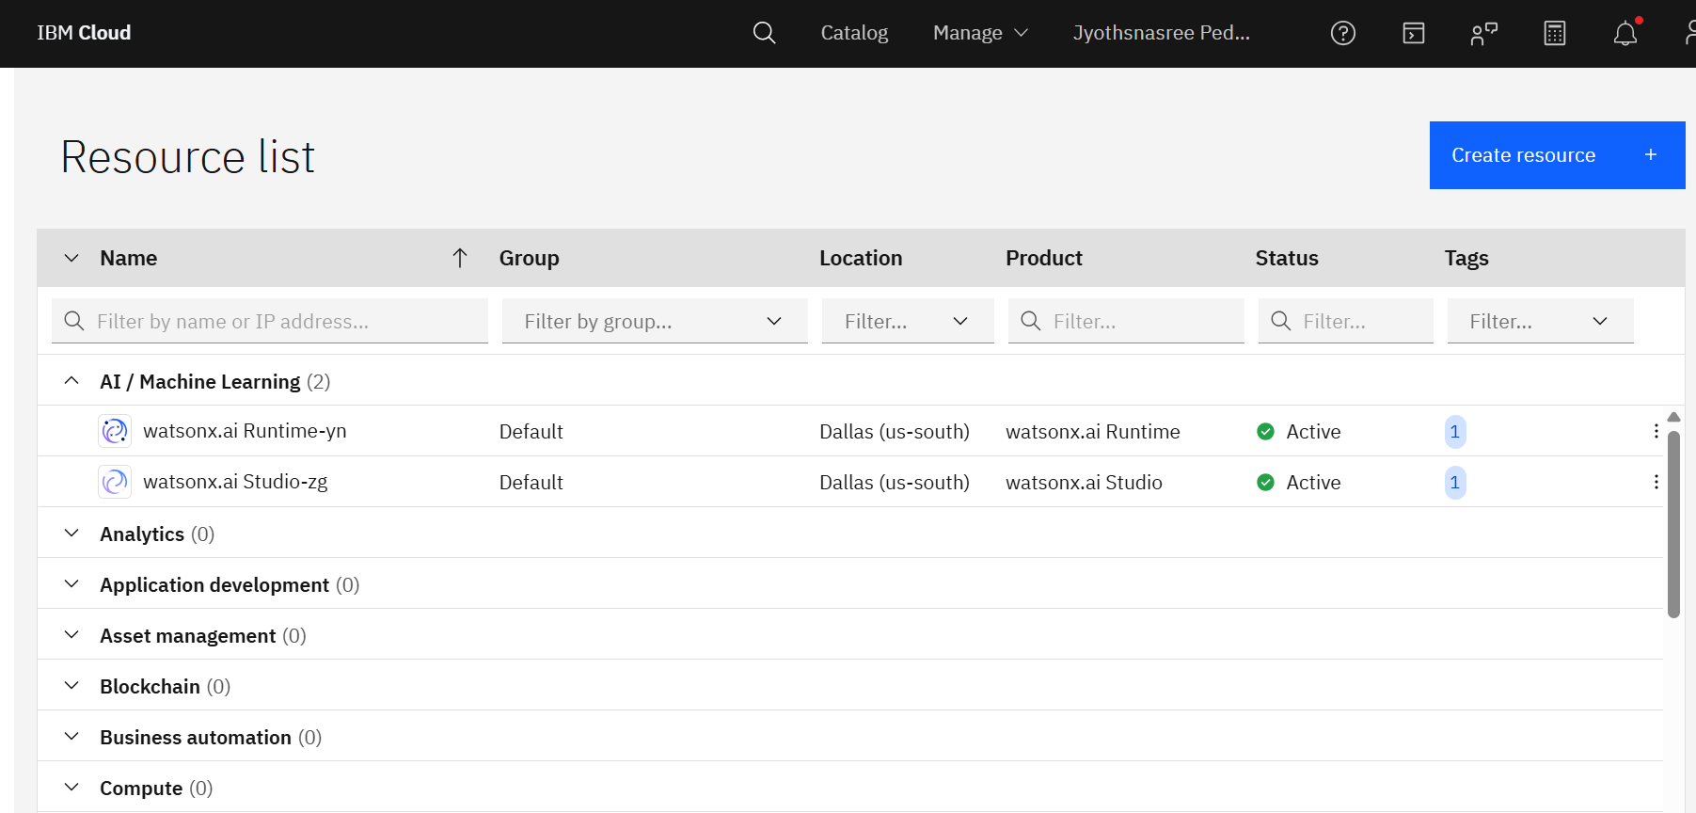
WORKING SCREENSHOTS: Prompt lab and watsonx Orchestrate

Slide 9
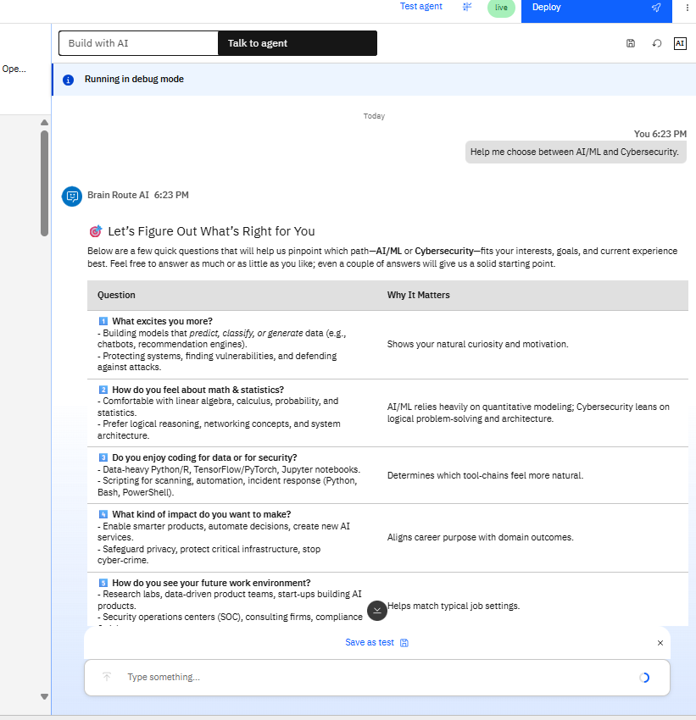
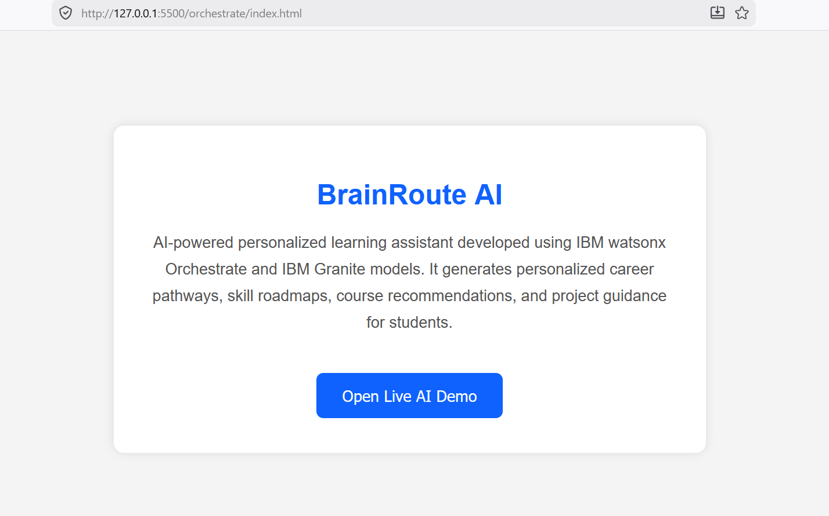
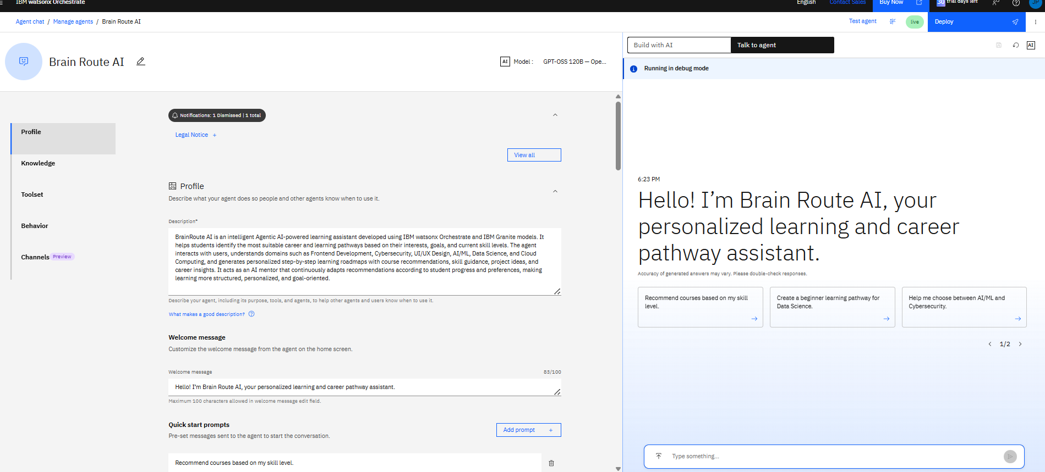
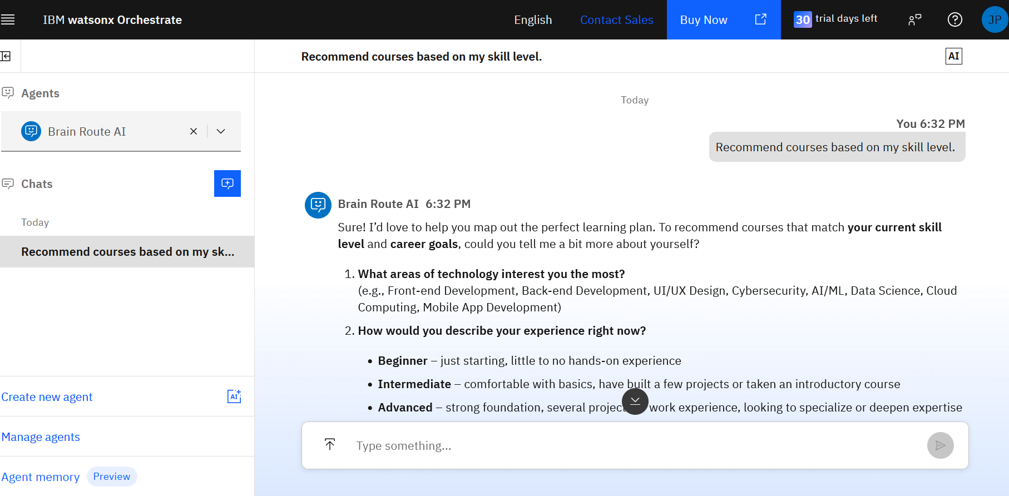
IBM watsonx Orchestrate

Slide 10
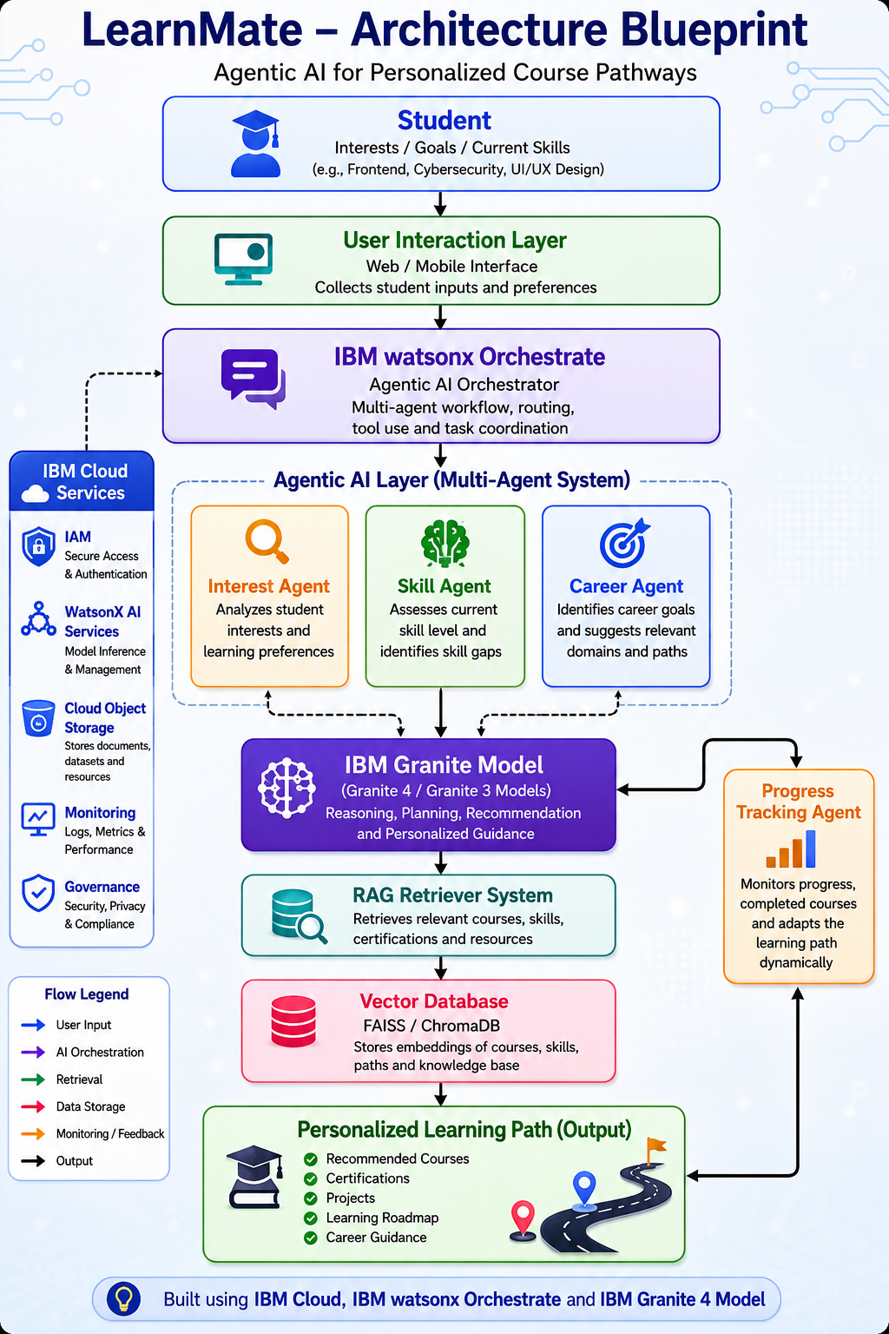
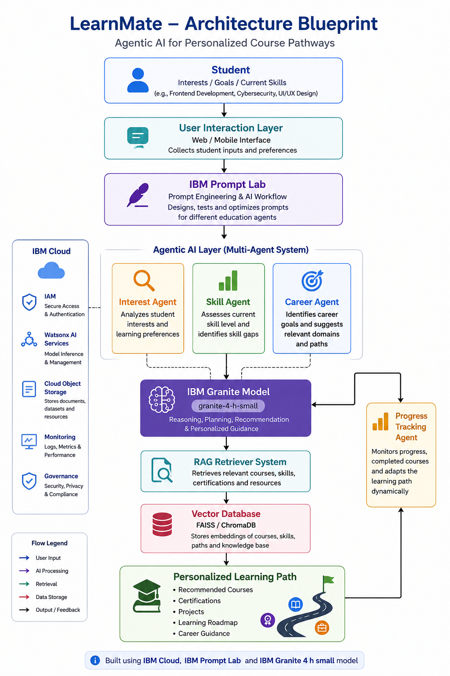
Architecture Blueprint:

Slide 11

Role of Agentic AI in the solution
Role of Agentic AI in this BRAIN ROUTE AI :
Agentic AI enables Brain Route AI to behave like an intelligent autonomous career mentor instead of a basic chatbot.
The system uses multiple AI agents that collaborate together to deliver personalized educational guidance. Each agent performs a specialized task such as understanding user interests, recommending courses, generating roadmaps, and tracking progress.
The AI system continuously adapts based on user interactions and learning progress, making recommendations more accurate and personalized over time.
Agentic AI also helps in decision-making by analyzing multiple factors including skill levels, learning pace, career goals, and industry trends.
This creates a proactive, adaptive, and goal-driven learning ecosystem that helps students stay focused and career-ready.

Slide 12
Technology Used
IBM Granite model - IBM-granite 4-h small is used For natural language understanding, reasoning, and personalization
IBM watsonx Orchestrate
IBM Cloud – It provides the infrastructure to build, deploy, and scale the Brain Route AI efficiently. IBM Cloud enables a reliable, secure, and scalable environment for deploying the Agent.
RAG– RAG to fetch real data first, then generate intelligent answers, making the AGENTIC AI COUCH more trustworthy and effective.
IBM Watsonx.ai - For model deployment, embeddings, and AI governance

Slide 13
Novelty and Uniqueness
Personalized Learning Roadmaps
Generates adaptive course pathways according to each student’s goals and skill levels.
Dynamic Recommendation System
Continuously updates recommendations based on progress and preferences.
RAG-Based Retrieval
Combines retrieval with AI generation to provide accurate and trustworthy learning suggestions.
Career-Focused Guidance
Aligns learning recommendations with industry-required skills and certifications.
Scalable and Intelligent
Built using IBM Cloud and IBM Granite Models for enterprise-grade reliability and scalability.
AI Mentor Experience
Acts like a personalized AI learning coach available anytime for guidance and support

Slide 14
Git Hub Link
https://github.com/jyothsna0012/Brain-Route-AI-
Orchestrate link: https://us-south.watson-orchestrate.cloud.ibm.com/chat
·
·
·

Slide 15
Future Scope
1. Integration with Job Platforms
The system can connect with LinkedIn, Internshala, and other job platforms to recommend skills according to current industry demands.
2. AI Interview Preparation
Can provide mock interviews, resume analysis, and career preparation guidance using AI.
3. Multilingual Learning Support
Support for regional languages to make learning accessible to more students.
4. Integration with Learning Platforms
Can integrate with Coursera, Udemy, edX, and YouTube Learning resources for automated recommendations.
·
·
·

Slide 16


